Slide 1
Long Term Memory

Slide 2
The Nature of Long-Term Memory
Memory, the internal repository of stored information, relies on a set of processes by which information is encoded, consolidated, and retrieved.
Long-term memory, information that is acquired in the course of an experience and that persists so that it can memory can be consciously retrieved, so that we can use our remembrance of things past to guide present thought and action.
By contrast, other forms of long-term memory influence our present thinking and behavior while operating outside awareness.
Chapter 5

Slide 3
The Forms of Long-Term Memory
Theorists believe that there are multiple forms of long-term memory that differ in their basic information processing properties and in the brain structures that support them.
These various forms of memory are thought to fall into two general classes, described as declarative and nondeclarative.
Chapter 5

Slide 4
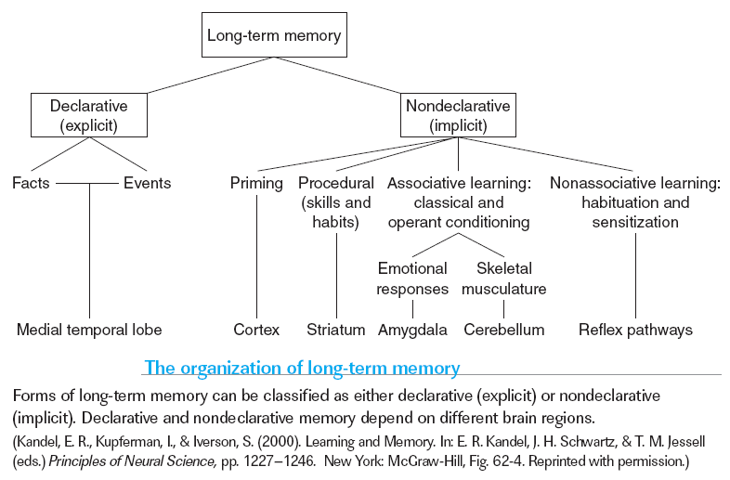
The Forms of Long-Term Memory
Chapter 5

Slide 5
The Forms of Long-Term Memory
Declarative memory (also known as explicit memory) refers to forms of long-term memory that can ordinarily be consciously recollected and “declared,” or described to other people, such as memory for facts, ideas, and events.
Declarative memory encompasses episodic memory, the memory of events in our own personal past, and semantic memory, our general knowledge about things in the world and their meaning, a distinction proposed by Endel Tulving in 1972.
Tulving defined episodic memory as the conscious knowledge of temporally dated, spatially located, and personally experienced events or episodes.
Chapter 5

Slide 6
The Forms of Long-Term Memory
Tests that assess declarative memory are termed explicit memory tests because they require the retrieval of an explicit description or report of knowledge from memory.
Declarative memory is highly flexible, involving the association of multiple pieces of information into a unified memory representation; thus, we may have different routes to retrieval of a given memory.
Both forms of declarative memory, episodic and semantic, depend on the operation of the medial temporal lobes.
Chapter 5

Slide 7
Declarative Systems
Semantic Memory - fact based knowledge system.
  Meanings of words.
  Mental Dictionary.
  Encoded in “gist” format.

Slide 8
Declarative Systems
Episodic memory - memory of events.
  Mental diary.
  Evolved out of semantic memory
Source amnesia: semantic memory w/o accompanying episodic memory

Slide 9
Declarative Systems
Episodic memory is dependant on semantic memory but semantic memory is independent of episodic memory

Slide 10
Declarative Systems
This means that the semantic memory system can operate without an episodic system
  Slower learning of new info
  OR:
  Episodic memory provides an advantage by reducing proactive & retroactive interference

Slide 11
The Power of Memory:
The Story of H.M.
H.M. suffers from a severe anterograde amnesia, the inability consciously to remember information encountered after brain damage.
H.M. also demonstrates some retrograde amnesia, the forgetting of events that occurred before the damage to the brain.
An important aspect of H.M.’s retrograde amnesia is that it is temporally graded: The closer an event had occurred to his surgery, the more likely it is to have been forgotten.
Chapter 5

Slide 12
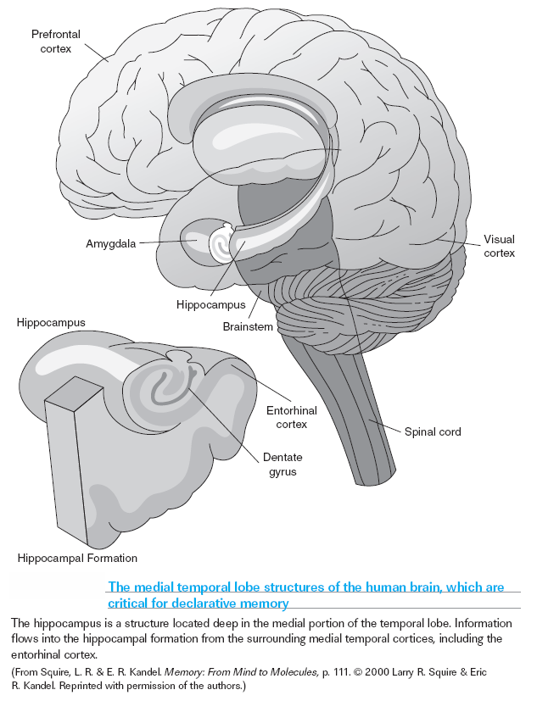
Chapter 5

Slide 13
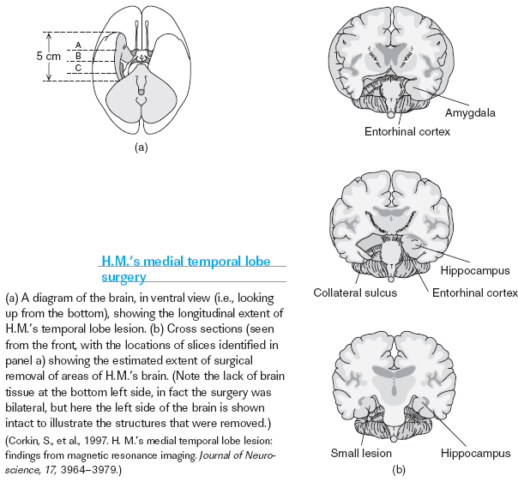
Chapter 5

Slide 14
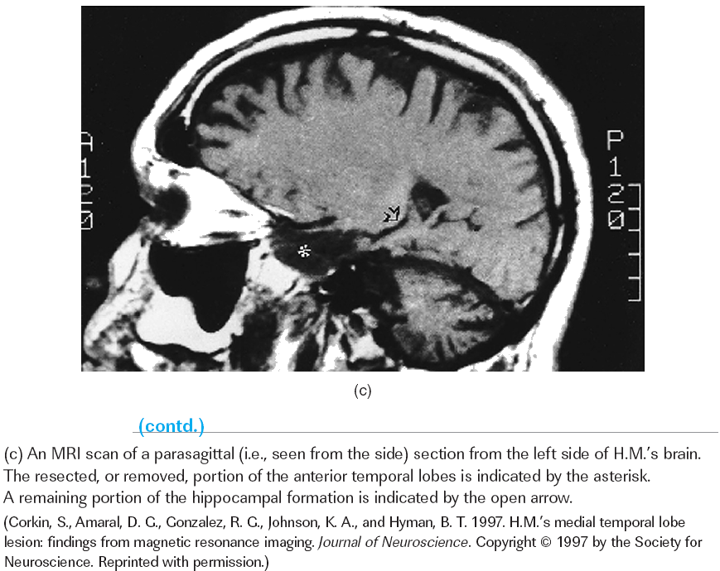
Chapter 5

Slide 15
Multiple Memory Systems for Long-Term Learning and Remembering
Further tests of H.M.’s memory abilities initiated a second landmark insight into the organization of memory: the medial temporal lobes are not necessary for all types of long-term memory.
H.M. was able to learn the skill of “mirror tracing.”
This task requires the remapping of visual perception onto motor actions because of the mirror-reversed nature of the visual input.
Chapter 5

Slide 16
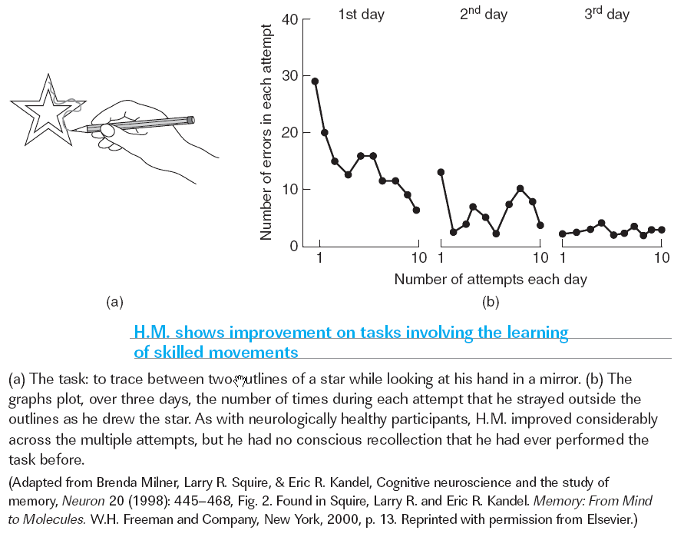
Chapter 5
Notes:
Comprehension Check:
1. What are the differences between declarative and nondeclarative memory?
2. What are the two forms of amnesia?

Slide 17
Encoding: How Episodic Memories are Formed
The Importance of Attention
Levels of Processing and Elaborative Encoding
Enhancers of Encoding: Generation and Spacing
Episodic Encoding, Binding, and the Medial Temporal Lobe
Consolidation: The Fixing of Memory
Chapter 5

Slide 18
Encoding: How Episodic Memories are Formed
Encoding is the term used for the various processes by which information is transformed into a memory representation.
Elaboration involves interpreting information, connecting it with other information, and mulling it over.
Other influences that strengthen encoding are conscious retrieval of the information, and practice that is “distributed,” or spaced out, in time.
Chapter 5

Slide 19
The Importance of Attention
One of the more obvious and consequential reasons for poor encoding is failure to attend to an event while it is happening.
When your attention to information is divided, for example because you are distracted, encoding is weaker and later attempts to remember are likely to fail.
One of the more obvious and consequential reasons for poor encoding is failure to attend to an event while it is happening. When your attention to information is divided, for example because you are distracted, encoding is weaker and later attempts to remember are likely to fail.
Chapter 5

Slide 20
Levels of Processing and Elaborative Encoding
Levels-of-Processing Theory: Argument and Limitations
The Brain, Semantic Elaboration, and Episodic Encoding
Chapter 5
Notes:
Evidence that attention is central to encoding might seem to suggest the conclusion that intent is required for effective memory formation. But not so fast: although in­tent to encode can motivate attention, intention per se is not required for effective encoding. Encoding is an automatic by-product of attending to and processing a stimulus (Craik & Lockhart, 1972). What influences encoding efficacy is the way the stimulus is processed, not the reason that processing was performed. (p. 203)

Slide 21
Levels-of-Processing Theory: Argument and Limitations
Levels-of-processing theory draws on the fact that there are various aspects of any given stimulus that can be attended and processed.
Most studies testing levels-of­processing theory have used instructions that reveal incidental learning, learning that occurs not as the result of a purposeful attempt but as a by-product of per­forming a task.
Chapter 5

Slide 22
So what now?
Transfer appropriate processing is the principle that processing at encoding is most effective to the extent that that processing overlaps with the processing to be performed at retrieval.
The encoding specificity principle, states that our ability to remember a stimulus depends on the similarity between the way the stimulus is processed at encoding and the way it is processed at test.

Slide 23
Encoding - Diver Study
STUDY >>>>> TEST | LAND | WATER
LAND | YAY
WATER |  | YAY

Slide 24
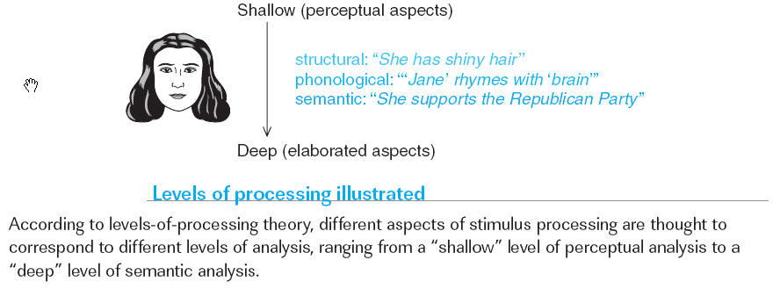
Levels-of-Processing Theory: Argument and Limitations
Chapter 5

Slide 25
The Brain, Semantic Elaboration, and Episodic Encoding
Because semantic processing tends to yield higher levels of memory performance (on standard tests) than does nonsemantic processing, it is reasonable to ask whether brain regions that are more active during semantic processing tasks are regions that support encoding processes that influence learning.
Divided attention diminishes left frontal lobe activation and episodic encoding during intentional learning, learning that occurs as the result of a purposeful attempt
There is greater activation in the left inferior frontal and medial temporal lobes during the encoding of words that were later remembered compared to words that were later forgotten.
Chapter 5

Slide 26
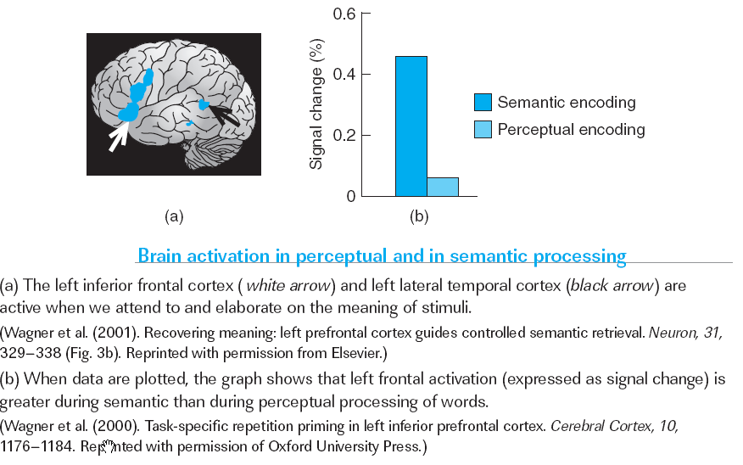
The Brain, Semantic Elaboration, and Episodic Encoding
Chapter 5

